Slide 1
An Intro to Linear Regression
McKay Johns

Slide 2
What is Linear Regression?
Comparing the relationship between two variables
We have independent and dependent variables
Independent
The variable we are using to predict the dependent variable - (x)
Dependent
The variable being predicted - (y)

Slide 3
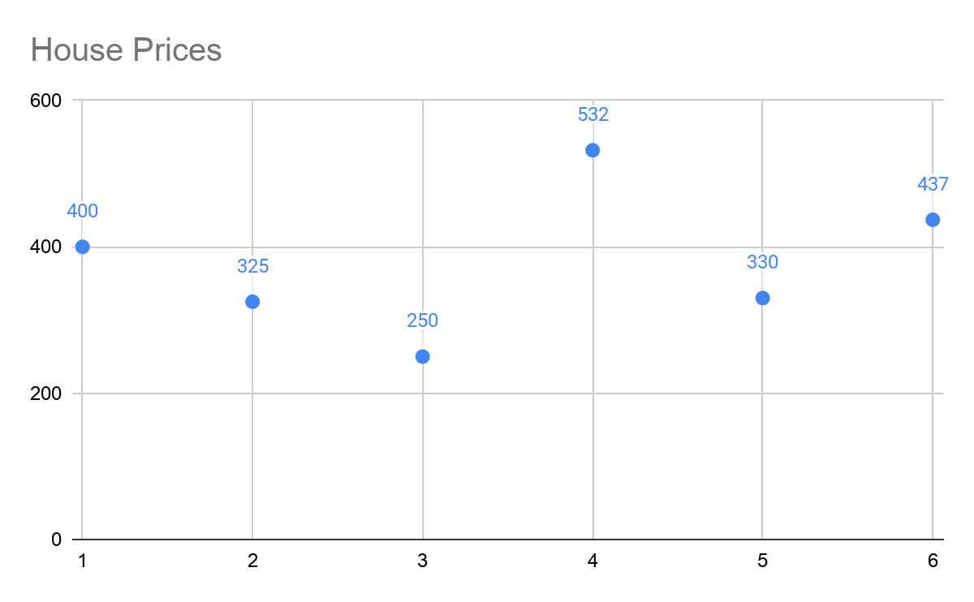
Goodness of Fit
This is the best line for our relationship
For one variable, it is the average. For this variable it is 379
This is our base model that we will compare future models too
Price ($ in thousands)
400
325
250
532
330
437

Slide 4
Residuals or Errors
Residuals are the difference between the observed value and the line of best fit
Price ($ in thousands) | Residual
400 | 21
325 | -54
250 | -129
532 | 153
330 | -49
437 | 58
AVG = 379

Slide 5
Squaring the Residuals
Price ($ in thousands) | Residual | SSE
400 | 21 | 441
325 | -54 | 2916
250 | -129 | 16641
532 | 153 | 23409
330 | -49 | 2401
437 | 58 | 3364
We now want to square those residuals
This makes all numbers positive
It also puts greater emphasis on larger residuals
We add all of the squared errors to get the SSE
SSE stands for sum of squared errors
The goal with linear regression is to minimize the SSE
Our new regression line should minimize this
With our data, our SSE = 49172

Slide 6

Least Squares Method
We use the least squares method to calculate our regression line
The regression line is the line with the smallest SSE
The goal is to make the difference between our observed values and our predicted values as small as possible
We observe this in this function:
y = the observed value
y-hat = our predicted variable

Slide 7
Introducing another variable - Simple Linear Regression
Simple linear regression compares the relationship of 2 variables
Price will be our dependent variable
Number of bedrooms will be our independent variable
Our model will try to predict the price of a house given the number of bedrooms
What we will do in the next steps will be calculating the least squares regression line
This line is the line of best fit for our data

Slide 8
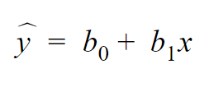
Calculating the Least Squares Regression Line
The Least Squares Regression Line is calculated by the following formula
Our y-hat is our predicted or dependent variable
b0 is our intercept while b1 is our slope
X is our independent variable
In the next slide we will calculate the the intercept and the slope...

Slide 9


The Slope and Intercept
Our slope is calculated by the following formula
We calculate our intercept by doing

Slide 10




Calculations
Price (y) | Bedrooms(x)
400 | 5 | 1.83 | 21 | 38.5 | 3.36
325 | 3 | -0.17 | -54 | 9 | 0.03
250 | 1 | -2.17 | -129 | 279.5 | 4.69
532 | 4 | 0.83 | 153 | 127.5 | 0.69
330 | 2 | -1.17 | -49 | 57.17 | 1.36
437 | 4 | 0.83 | 58 | 48.33 | 0.69
Avg = 379 | Avg = 3.17 | Sum = 0 | Sum = 0 | Sum = 560 | Sum = 10.83

Slide 11
Slope & Intercept
Slope = /
Slope = 560 / 10.83 = 51.69 (in thousands of dollars)
Intercept =
Intercept = 379 - 51.69*3.17 = 215 (in thousands of dollars)

Slide 12

Least Squares Regression Line
From the calculations we did we can plug the numbers into this formula:
And we get
This is our model line for making predictions

Slide 13
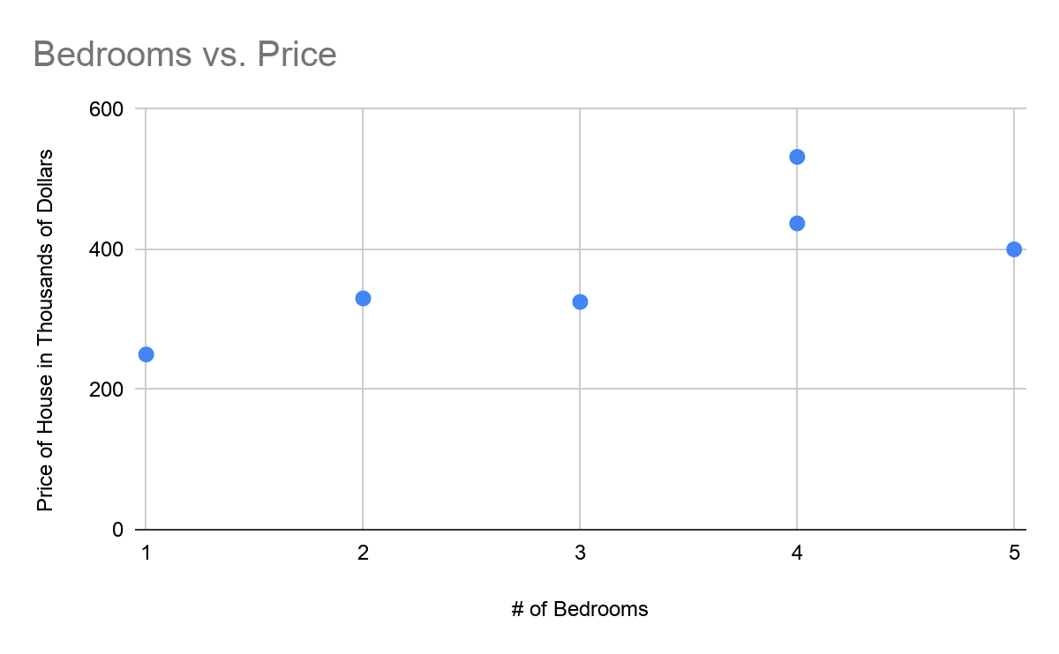
Step 1: Plot the Points

Slide 14
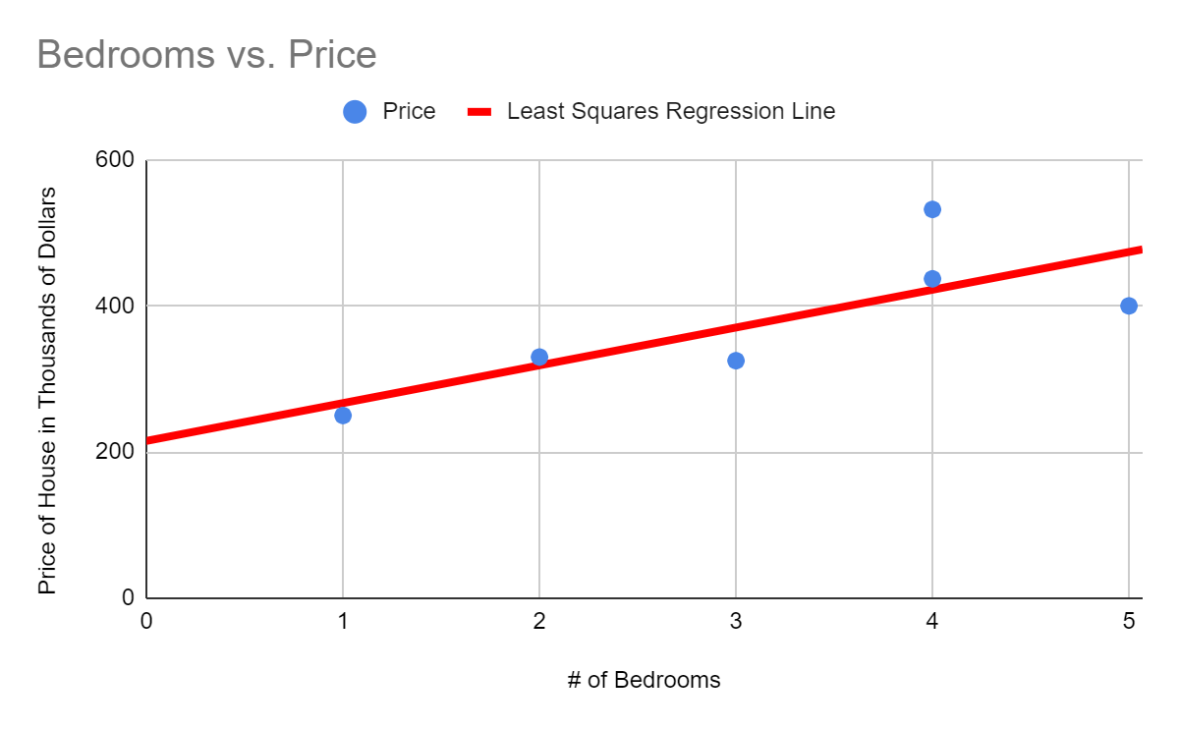
Step 2: Plot our Least Squares Regression Line

Slide 15
Step 3: Interpret our Model
For every 1 bedroom increase (x), we expect the house price to increase by 51.59 ( or $51,590) in thousands of dollars
The intercept means that when the house has 0 bedrooms, the price is expected to be 215 ($215,000)

Slide 16

Validating Our Model
To validate our model, we need to find the SSE of our line
We plug in our independent variables to our least squares regression equation to find the predicted values, then subtract them from our observed values
Price (y) | Bedrooms (x)
400 | 5 | 473.77 | 400 - 474 = -73.77 | 5441.90
325 | 3 | 370.38 | 325 - 370 = -45.38 | 2059.76
250 | 1 | 267.00 | 250 - 267 = -17.00 | 289.00
532 | 4 | 422.08 | 532 - 422 = 109.92 | 12083.08
330 | 2 | 318.69 | 330 - 319 = 11.31 | 127.86
437 | 4 | 422.08 | 437 - 422 = 14.92 | 222.70
If we sum up our SSE column we get 20224.31, which compared to our old model SSE of 49172 is better

Slide 17
SST, SSR, SSE
To determine how well our model actually fits the data, we can use the variables SST, SSR, and SSE
We use the formula SST = SSR - SSE
SST, or Total Sum of Squares, is the maximum our SSE can be. This is also equal to our SSE for our model with only one variable
SSR, or the Sum of Squares due to Regression, is the difference between our SST and SSE (SST - SSE)
From our model
- SST = 49172 - SSE = 20224.31
- SSR = 49172 - 20224.31 = 28,947.69

Slide 18


Coefficient of Determination
This is how well we can determine our regression equation fits the data
Otherwise known as
We calculate r-squared by using the formula
For our model, our r-squared = 28,947.69 / 49172 = .589 or 58.9%
This means that 58.9% of the total sum of squares can be explained by using the regression equation to predict house prices. The rest is due to error

Slide 19
Is this a good fit?
Typically, we want our r-squared to be as close to 1 or -1 as possible
58% is something we would call “ok”
We most likely need more data to determine house prices from number of bedrooms

